Slide 1
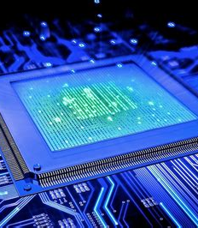



PRASENTATION ON HARDCOPY OUTPUT DEVICES
PRESENTED BY: GROUP-A
1

Slide 2

Introduction
Hard-copy output devices are the devices which produces output that are physically interactable by user.
2

Slide 3
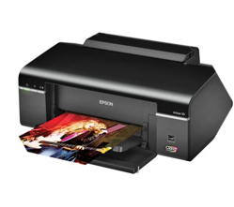
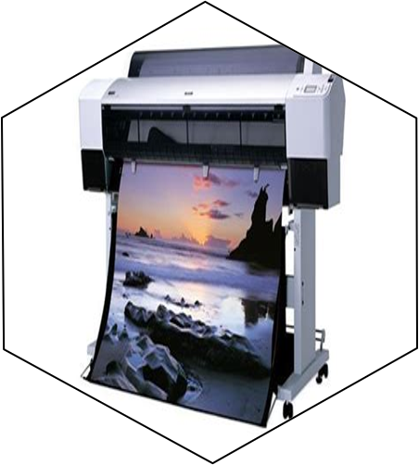
Types of hardcopy output devices
Printers
Plotters
A printer is a device that produces a physical copy of digital documents or images onto paper or other media. It converts electronic data from a computer or other digital sources into a tangible form, such as text and graphics.
Plotters are specialized printers used to create large-scale graphics and detailed drawings. Unlike traditional printers that use a fixed print head, plotters use pens or blades to draw lines and shapes on paper or other materials. They are commonly used for engineering diagrams.
3

Slide 4
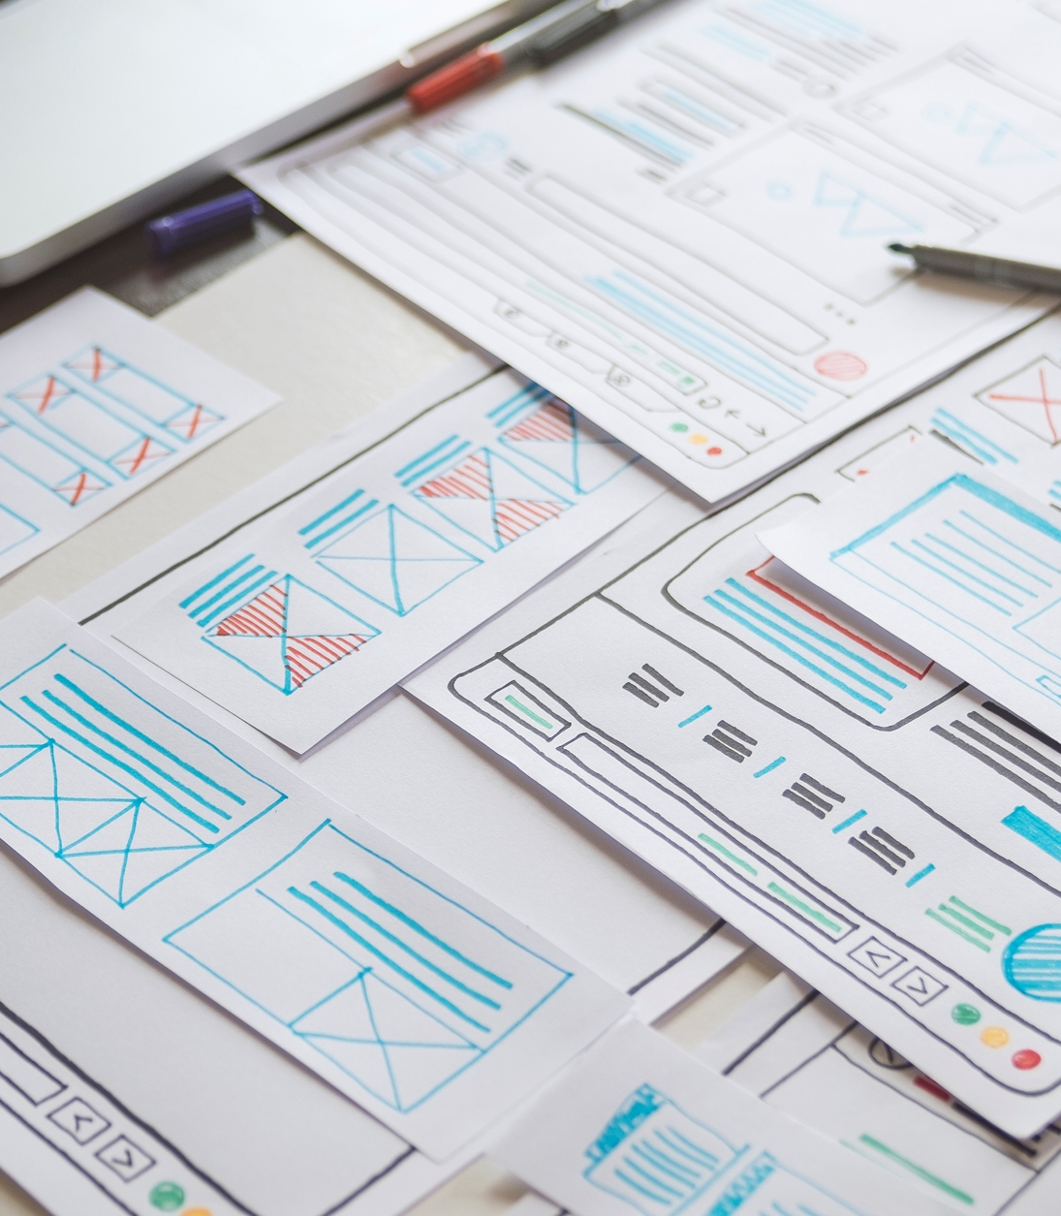
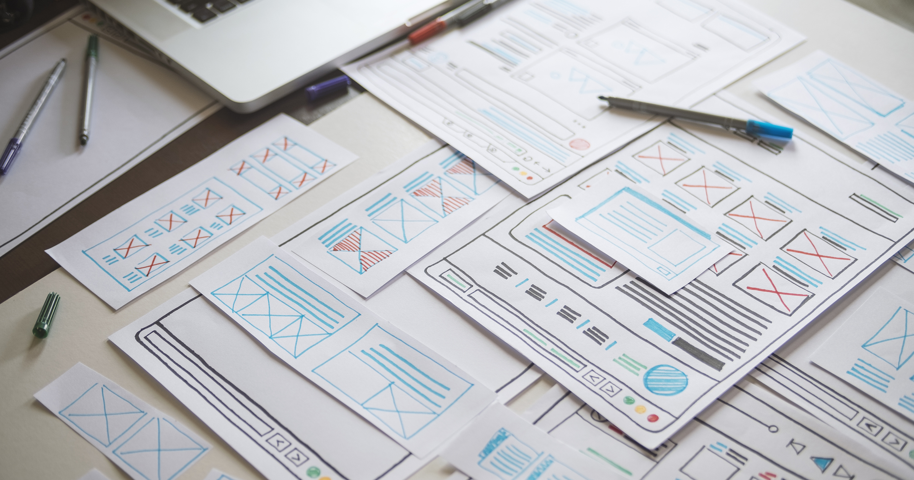
IMPACT PRINTER
Types of printers:
NON-IMPACT PRINTER
4

Slide 5
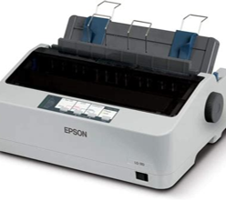
Types of hardcopy output devices
Impact Printer
Non-Impact Printer
An impact printer is a type of printer that creates text and images by physically striking an inked ribbon against paper. This action imprints characters or patterns onto the paper using a print head or a set of hammers.
A non-impact printer is a type of printer that creates text and images without physically striking the paper. Instead, it uses various technologies like inkjets, lasers, or heat to transfer ink or toner onto the paper.
5

Slide 6
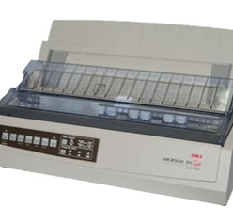
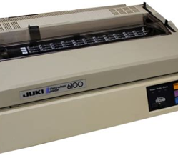
IMPACT PRINTERS
EXAMPLES:
Dot-Matrix Printer
Line Printer
Daisy-Wheel Printer
6

Slide 7
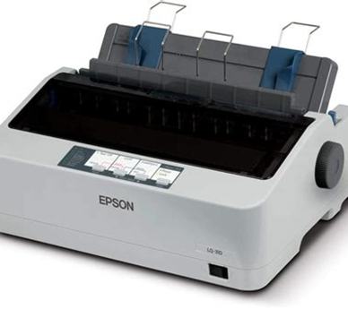
Dot-Matrix Printer
A dot matrix printer is a type of impact printer that prints by striking an inked ribbon with a grid of tiny pins. It creates text and images by forming patterns of dots on the paper. These printers are useful for printing multiple copies of forms and other documents that need to be durable.
7

Slide 8
Daisy-Wheel Printer
A daisy wheel printer is an early impact printer that produces high-quality text by striking a rotating wheel (shaped like a daisy) with pre-formed characters against an ink ribbon and paper. Each spoke on the wheel has a character, and the printer rotates the wheel to the correct position before striking to print the character.
8

Slide 9
Line Printer
A line printer is a type of printer that prints an entire line of text at once. It works by using a series of hammers or a rotating drum with characters to press an inked ribbon onto the paper. This method makes line printers very fast and efficient, especially for printing large amounts of text. They’re commonly used in settings where high-volume printing is needed.
9

Slide 10
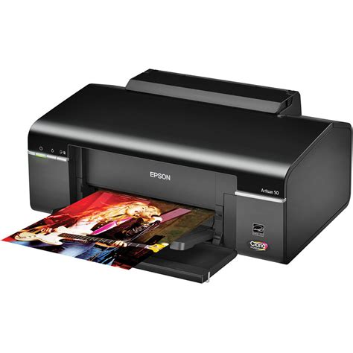
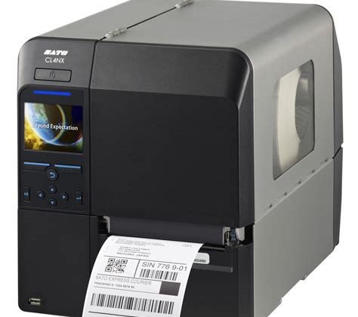
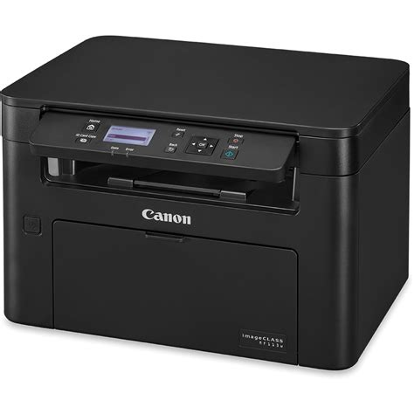
NON-IMPACT PRINTERS
EXAMPLES:
Ink-Jet Printer
Thermal Printer
Laser Printer
10

Slide 11
Ink-Jet Printer
An inkjet printer is a type of non-impact printer that creates images by spraying tiny droplets of ink onto paper. It uses cartridges filled with liquid ink in various colors to produce high-quality text and photo prints. Inkjet printers are known for their versatility, allowing for detailed color prints and handling various paper types and sizes.
11

Slide 12
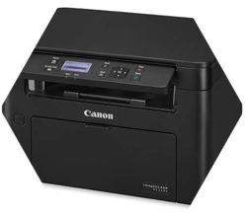
Laser Printer
A laser printer is a non-impact printer that uses laser technology to produce high-quality text and images. It works by using a laser beam to scan and create an electrostatic image on a rotating drum. The drum then attracts toner powder, which is transferred onto paper and fused with heat. Laser printers are known for their speed, precision, and sharp text quality, making them ideal for high-volume printing tasks.
12

Slide 13
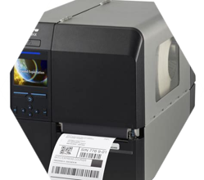
Thermal Printer
A thermal printer is a non-impact printer that uses heat to produce text and images. It works by applying heat to heat-sensitive paper or a ribbon, which then creates the desired print on the paper. Thermal printers are valued for their speed, quiet operation, and minimal maintenance requirements.
13

Slide 14
IMPORTANCE:
Accessibility
Documentation
Permanent Records
Presentation
Readability
14

Slide 15
WHY IS HARD-COPY OUTPUT NEEDED?
Permanent Records
Accessibility
Presentation
Readability
Documentation
Physical documents can be accessed without the need for electronic devices or power, making them reliable in low-tech or offline environments.
Hardcopy output provides a physical record of documents, which is useful for legal, archival, and personal reference.
Physical documents can be accessed without the need for electronic devices or power, making them reliable in low-tech or offline environments.
Hardcopy output provides a physical record of documents, which is useful for legal, archival, and personal reference.
Printed materials, such as reports and presentations, are often more professional and easier to review compared to digital formats.
Printed materials, such as reports and presentations, are often more professional and easier to review compared to digital formats.
Many people find printed text easier to read and less straining on the eyes compared to screens, especially for long documents.
Hardcopies are essential for official documents, contracts, and forms that require signatures or need to be submitted in physical form.
15

Slide 16
CONCLUSION :
In conclusion, hardcopy output devices play a crucial role in various settings by providing tangible, physical copies of digital documents. Whether it's a printer for everyday tasks, a plotter for detailed designs, or a thermal printer for receipts and labels, these devices offer reliability and durability that digital formats can’t always match. They are essential for creating permanent records, ensuring accessibility, and delivering high-quality prints that meet specific needs. Despite the growing reliance on digital solutions, hardcopy output devices remain indispensable for many professional and personal applications.
16

